Slide 1


Introduction to
Robotic Process Automation
TAXA BOT
Your Register No:220701095
Name: JAGANNATH P
Guide Name: MRS.JINU SOPHIA
Designation and Department : B.E and CSE

Slide 2
Abstract
Taxabot is a Telegram bot integrated with the Tamil Nadu tax department designed to fetch tax details by entering the assessment number and delivering the output through Telegram messages

Slide 3
Need for the Proposed System
The proposed system streamlines tax information retrieval by eliminating manual navigation of government websites, ensuring fast and user-friendly access to tax details.

Slide 4
Advantages of the Proposed System
Efficiency: Automates the process of retrieving tax information.
Convenience: Provides details directly on Telegram, accessible anytime and anywhere.
User-friendly: Simplifies complex website navigation for users.
Integration: Seamlessly connects to the Tamil Nadu tax department's database

Slide 5
Literature Survey
Paper 1: "Chatbots in Public Service Automation"
Advantages:
Demonstrates the use of chatbots to improve access to government services.
Highlights reduced response time and operational costs.
Disadvantages:
Limited to predefined queries, reducing flexibility for complex user needs.
Challenges in maintaining up-to-date data due to dynamic website content.

Slide 6
Main Objective
To develop an automated Telegram bot for efficiently fetching and delivering Tamil Nadu tax information through a user-friendly interface.

Slide 7
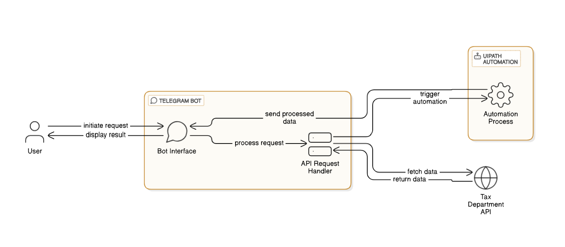
Architecture

Slide 8
System Requirements
Hardware
Processor: Minimum Dual-Core
RAM: 4GB or above
Storage: 100MB for bot setup
Software
Telegram API
Python 3.8
Web scraping libraries
UiPath for additional automation

Slide 9
Functional Description
Input: User enters the assessment number on Telegram.
Processing: Taxabot fetches the corresponding details from the Tamil Nadu tax department's website.
Output: The retrieved tax information is displayed in a Telegram chat message.

Slide 10
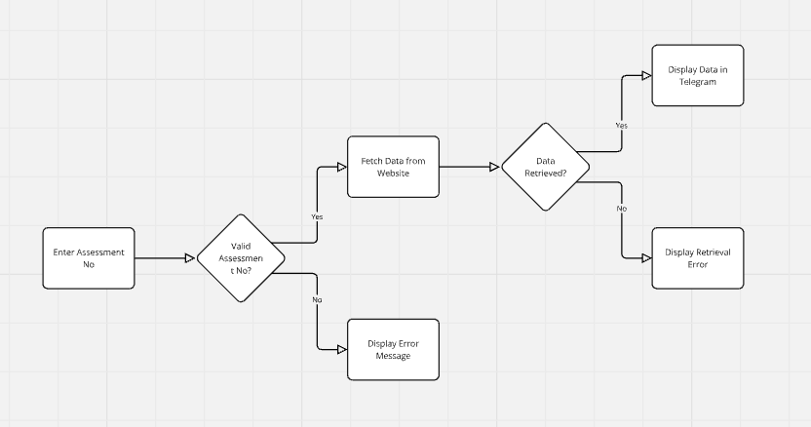
Table Design

Slide 11
Process Design
User sends an assessment number via Telegram.
Taxabot validates the input and accesses the Tamil Nadu tax department's website.
UiPath automates the data extraction process.
The data is formatted and sent back to the user through Telegram.

Slide 12
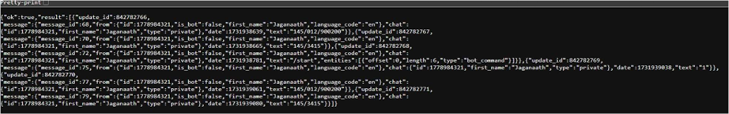
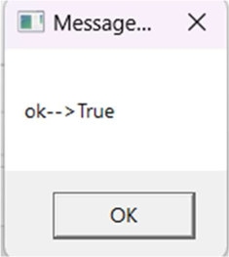
Implementation
Module-1: API ENDPOINT REQUEST AND RESPONSE
Module-2: TELEGRAM BOT

Slide 13
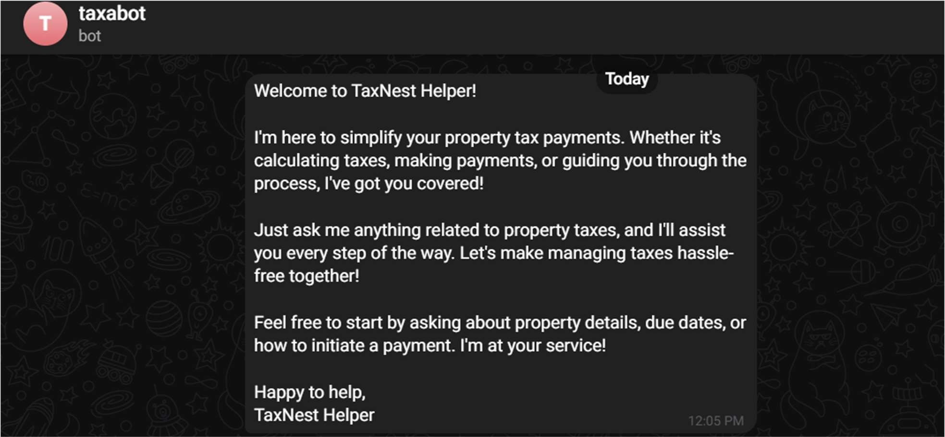
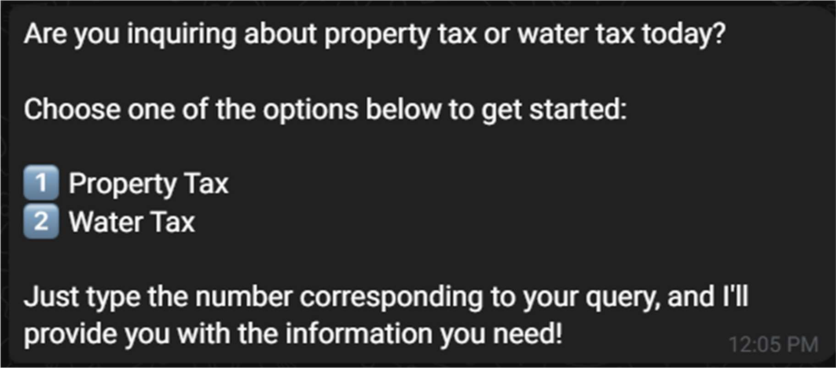
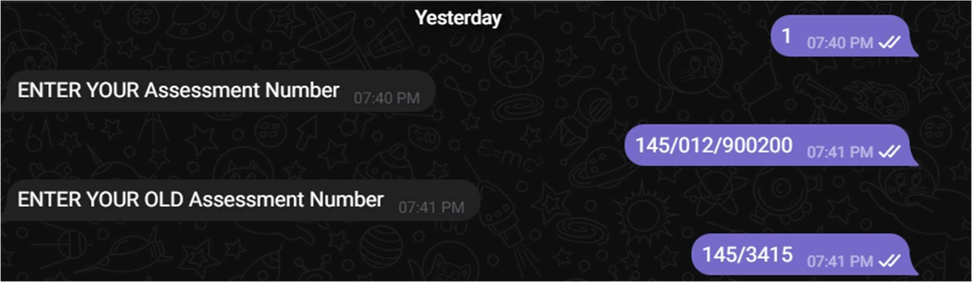

Slide 14
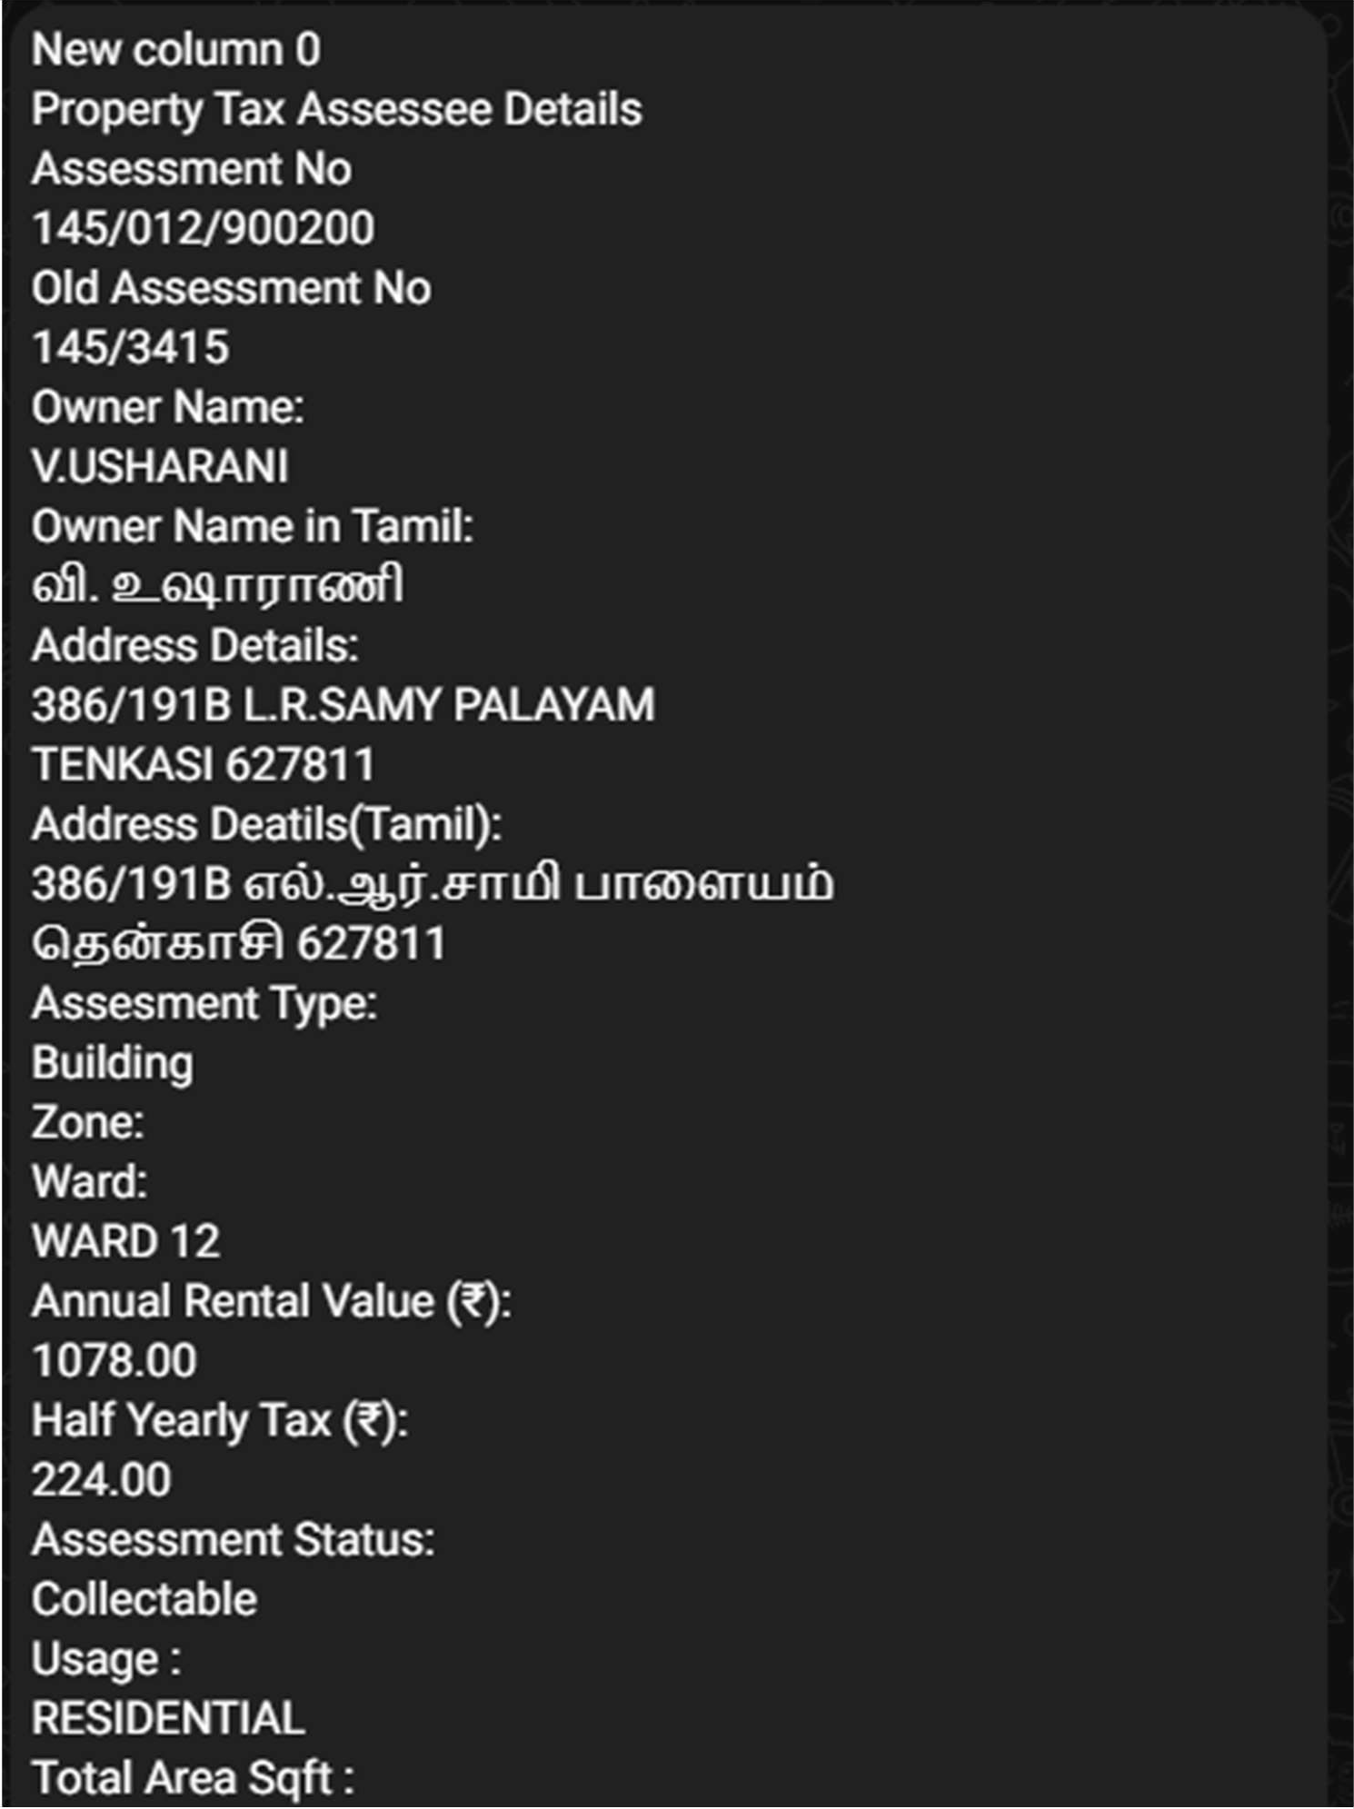
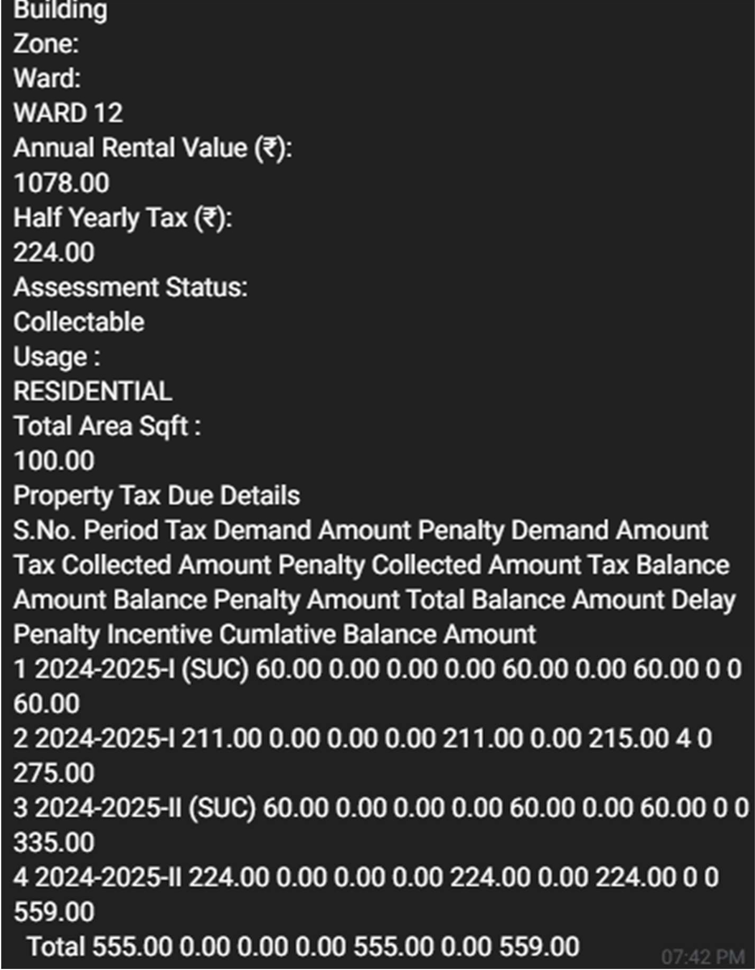
Testing
OUTPUT:
The following process output will be displayed here.

Slide 15
Conclusions
Taxabot provides a fast, efficient, and user-friendly approach to accessing Tamil Nadu tax information, reducing manual effort and time

Slide 16
Future Enhancement
Integration with additional government services.
Support for multiple languages.
Advanced analytics for tax payment trends.
Voice-based query system.

Slide 17
IEEE Paper
Title: "The AI Enabled Chatbot Framework for Intelligent Citizen-Government Interaction for Delivery of Services"
Authors: Not explicitly mentioned in the abstract; authored under IEEE Conference Publications.
Key Focus: Discusses an AI-enabled chatbot framework for improving citizen-government interactions by delivering efficient public services. It emphasizes automation and natural language processing for seamless service delivery

Slide 18
References
Tamil Nadu Tax Department Official Website
Telegram API Documentation
UiPath Documentation
Research papers on chatbot integration with public services

Slide 19
Queries
How does Taxa Bot ensure data accuracy?
Answer: Taxa Bot validates the user-provided assessment number, dynamically extracts data from the Tamil Nadu tax department website using UiPath uses fallback messages for errors to ensure reliability.
2. How does Taxa Bot handle multiple concurrent requests?
Answer: Taxa Bot processes requests asynchronously, employs rate-limiting and uses a scalable backend to efficiently handle multiple user queries without delays.

Slide 20
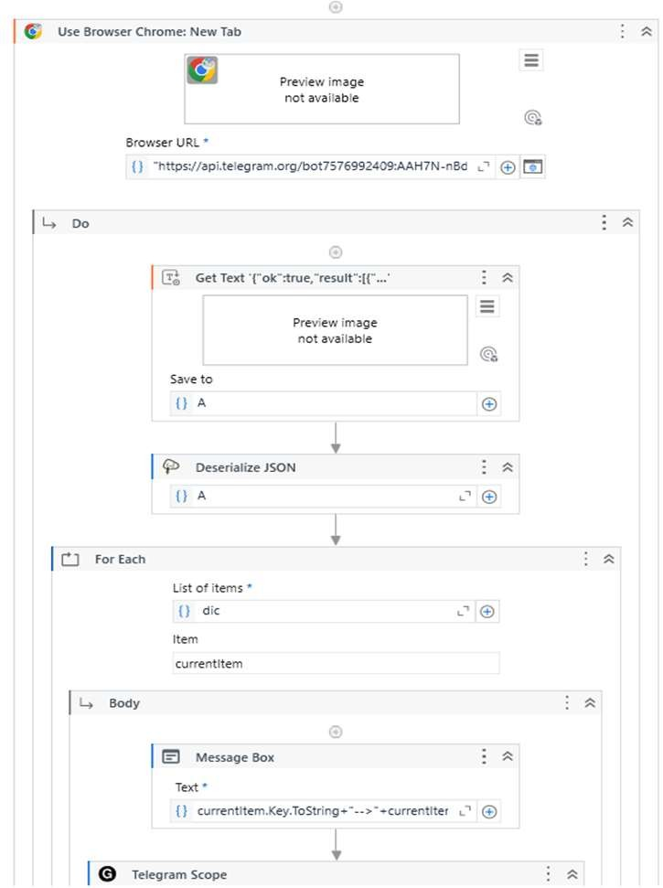
Demonstration
Step1: Open UiPath Studio and Run the Workflow

Slide 21
Step 2: Input Values
Step 3: Output

Slide 23
Thank You

